Slide 1
수위 예측 AI

Slide 2
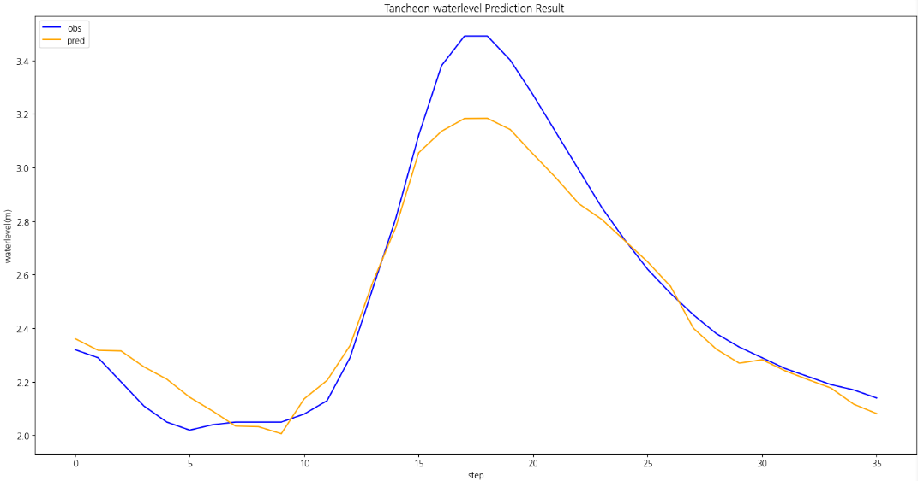
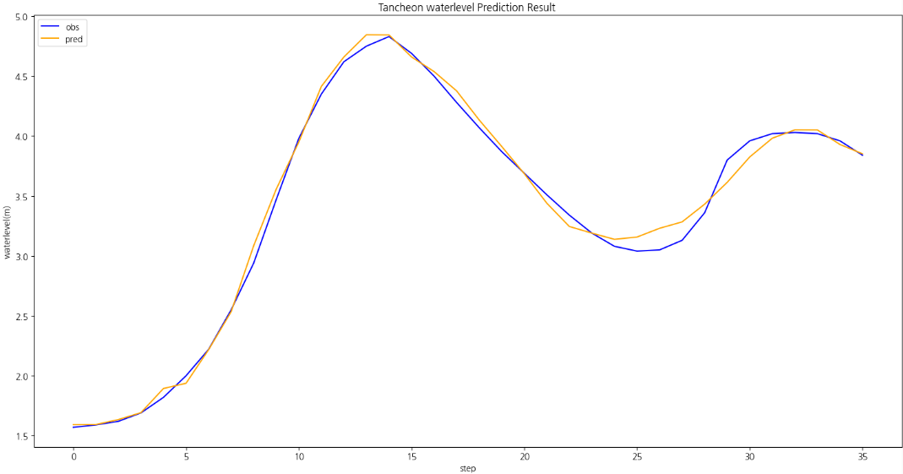
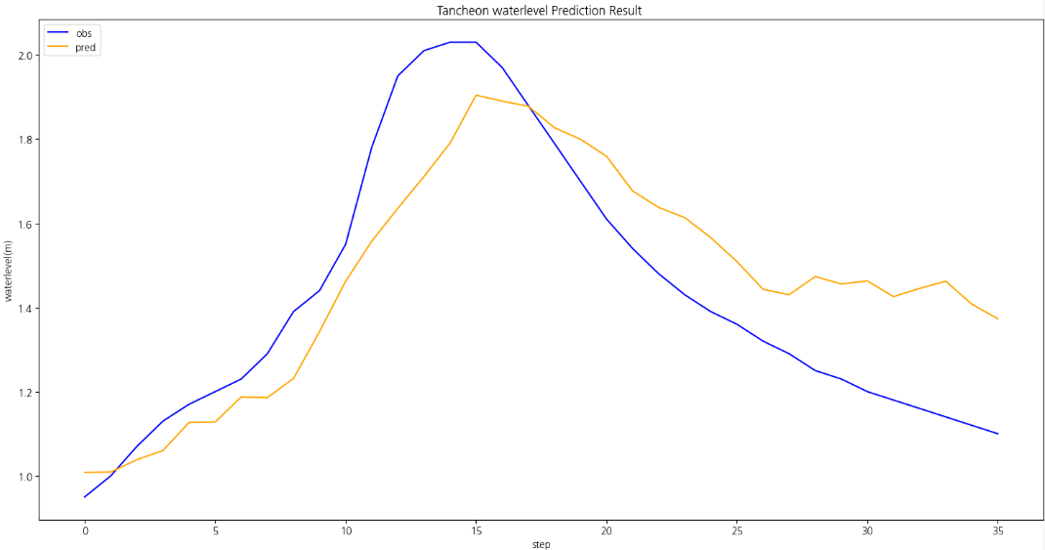
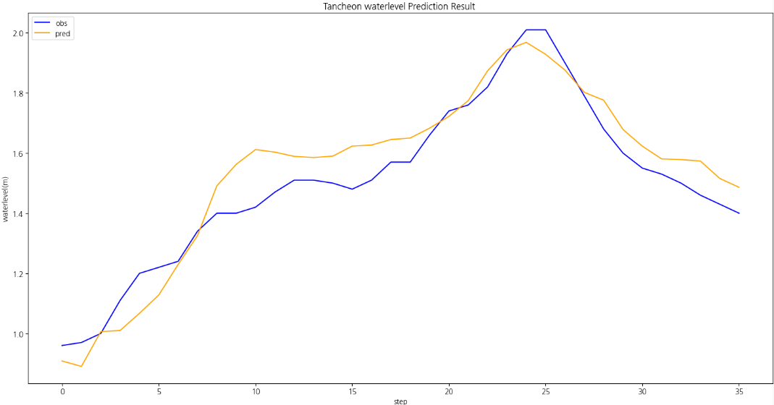
수위예측
smoothing = 1
 | 궁내교 | 대곡교
testdata_220630 | r2 : 0.9334831558683871 mse : 0.014662755503537002 mae : 0.08591636021931968 rmse : 0.12108986540390984 | r2 : 0.8461369366287653 mse : 0.11212509555879795 mae : 0.28038430240419177 rmse : 0.33485085569369233
testdata_220808 | r2 : 0.9933156779676867 mse : 0.0061528580861704455 mae : 0.05965378244717913 rmse : 0.07844015608201227 | r2 : 0.7864821009981524 mse : 0.11192937768607407 mae : 0.2791808260811699 rmse : 0.33455848171294966
testdata_250716 | r2 : 0.6786097511859852 mse : 0.03224258396157489 mae : 0.15377818557951184 rmse : 0.17956220081513505 | r2 : 0.7787861120789699 mse : 0.10215350102682166 mae : 0.23608912044101293 rmse : 0.319614613287349
testdata_250814 | r2 : 0.8931957393452244 mse : 0.007529922885038036 mae : 0.07411362230777739 rmse : 0.08677512826287286 | r2 : 0.6946340343597268 mse : 0.10599222036528559 mae : 0.2742249170939128 rmse : 0.32556446422373186

Slide 3
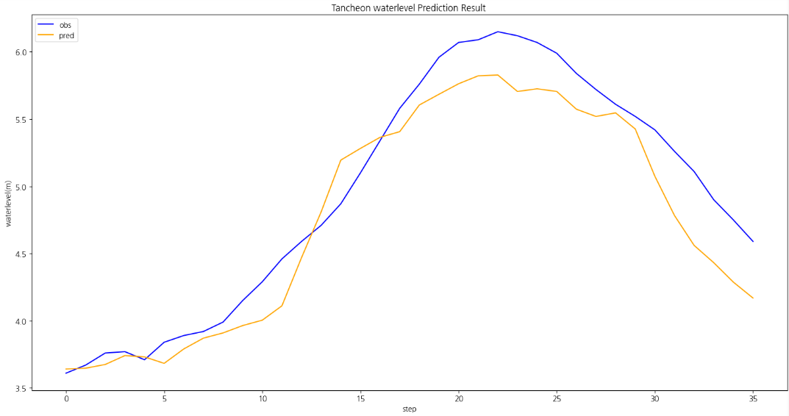
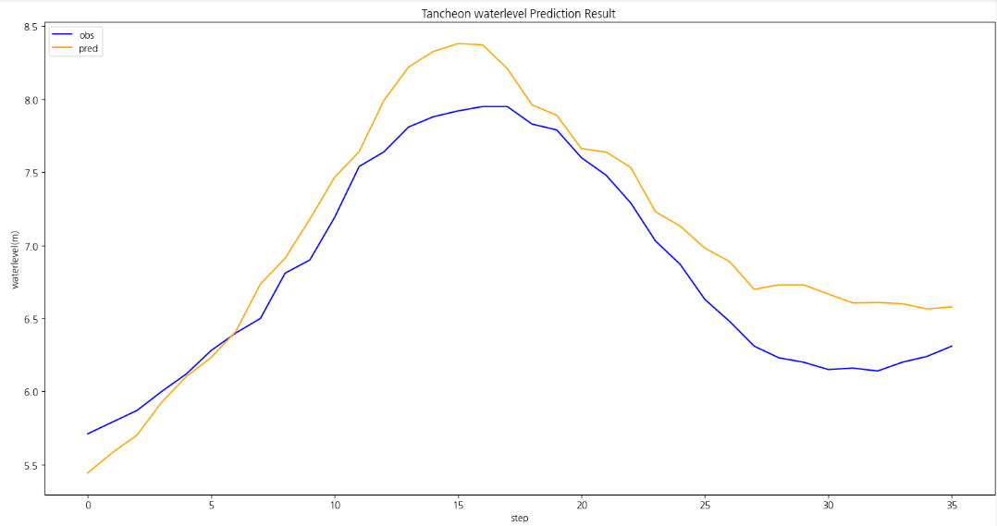
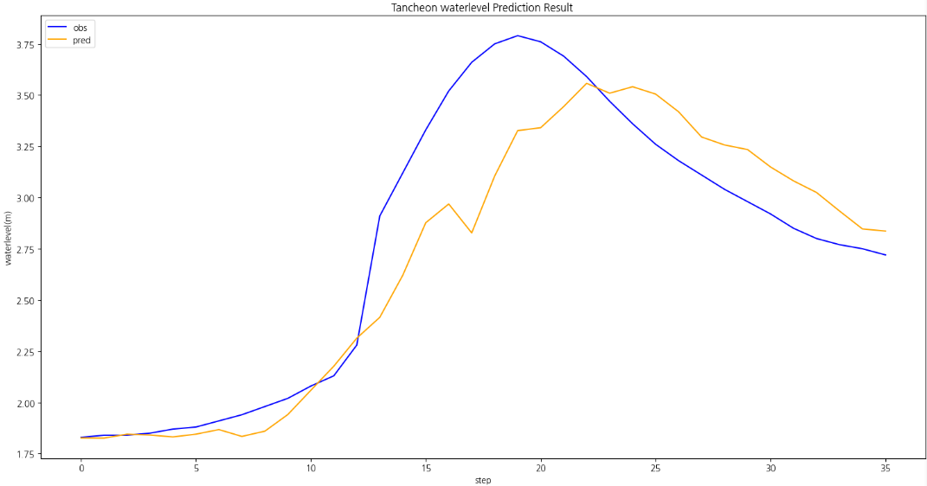
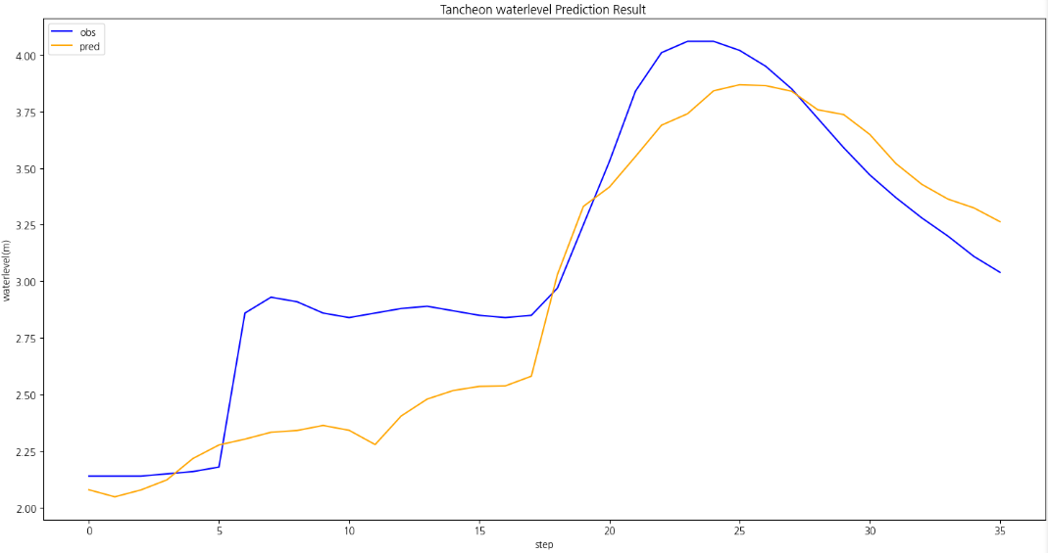
수위예측
smoothing = 2
 | 궁내교 | 대곡교
testdata_220630 | r2 : 0.7088730596475936 mse : 0.06417507027894874 mae : 0.19718893157111278 rmse : 0.2533279895292834 | r2 : 0.9004934548421246 mse : 0.07251370562948573 mae : 0.22338981760872734 rmse : 0.2692836898690408
testdata_220808 | r2 : 0.9773663276419933 mse : 0.020834091073780862 mae : 0.10682662063174778 rmse : 0.1443401921634472 | r2 : 0.8118272173611429 mse : 0.09864307656025555 mae : 0.2750794050428602 rmse : 0.3140749537296082
testdata_250716 | r2 : 0.5100765623979442 mse : 0.049150207978988454 mae : 0.16626809497674305 rmse : 0.22169846183270747 | r2 : 0.8130232584048014 mse : 0.08634326236947386 mae : 0.21145669579505919 rmse : 0.29384224061471126
testdata_250814 | r2 : 0.8737931172772833 mse : 0.008897848162957201 mae : 0.06456567585468291 rmse : 0.09432840591760894 | r2 : 0.7407194444433576 mse : 0.08999602075290633 mae : 0.2423573001225789 rmse : 0.29999336784820146

